Slide 1


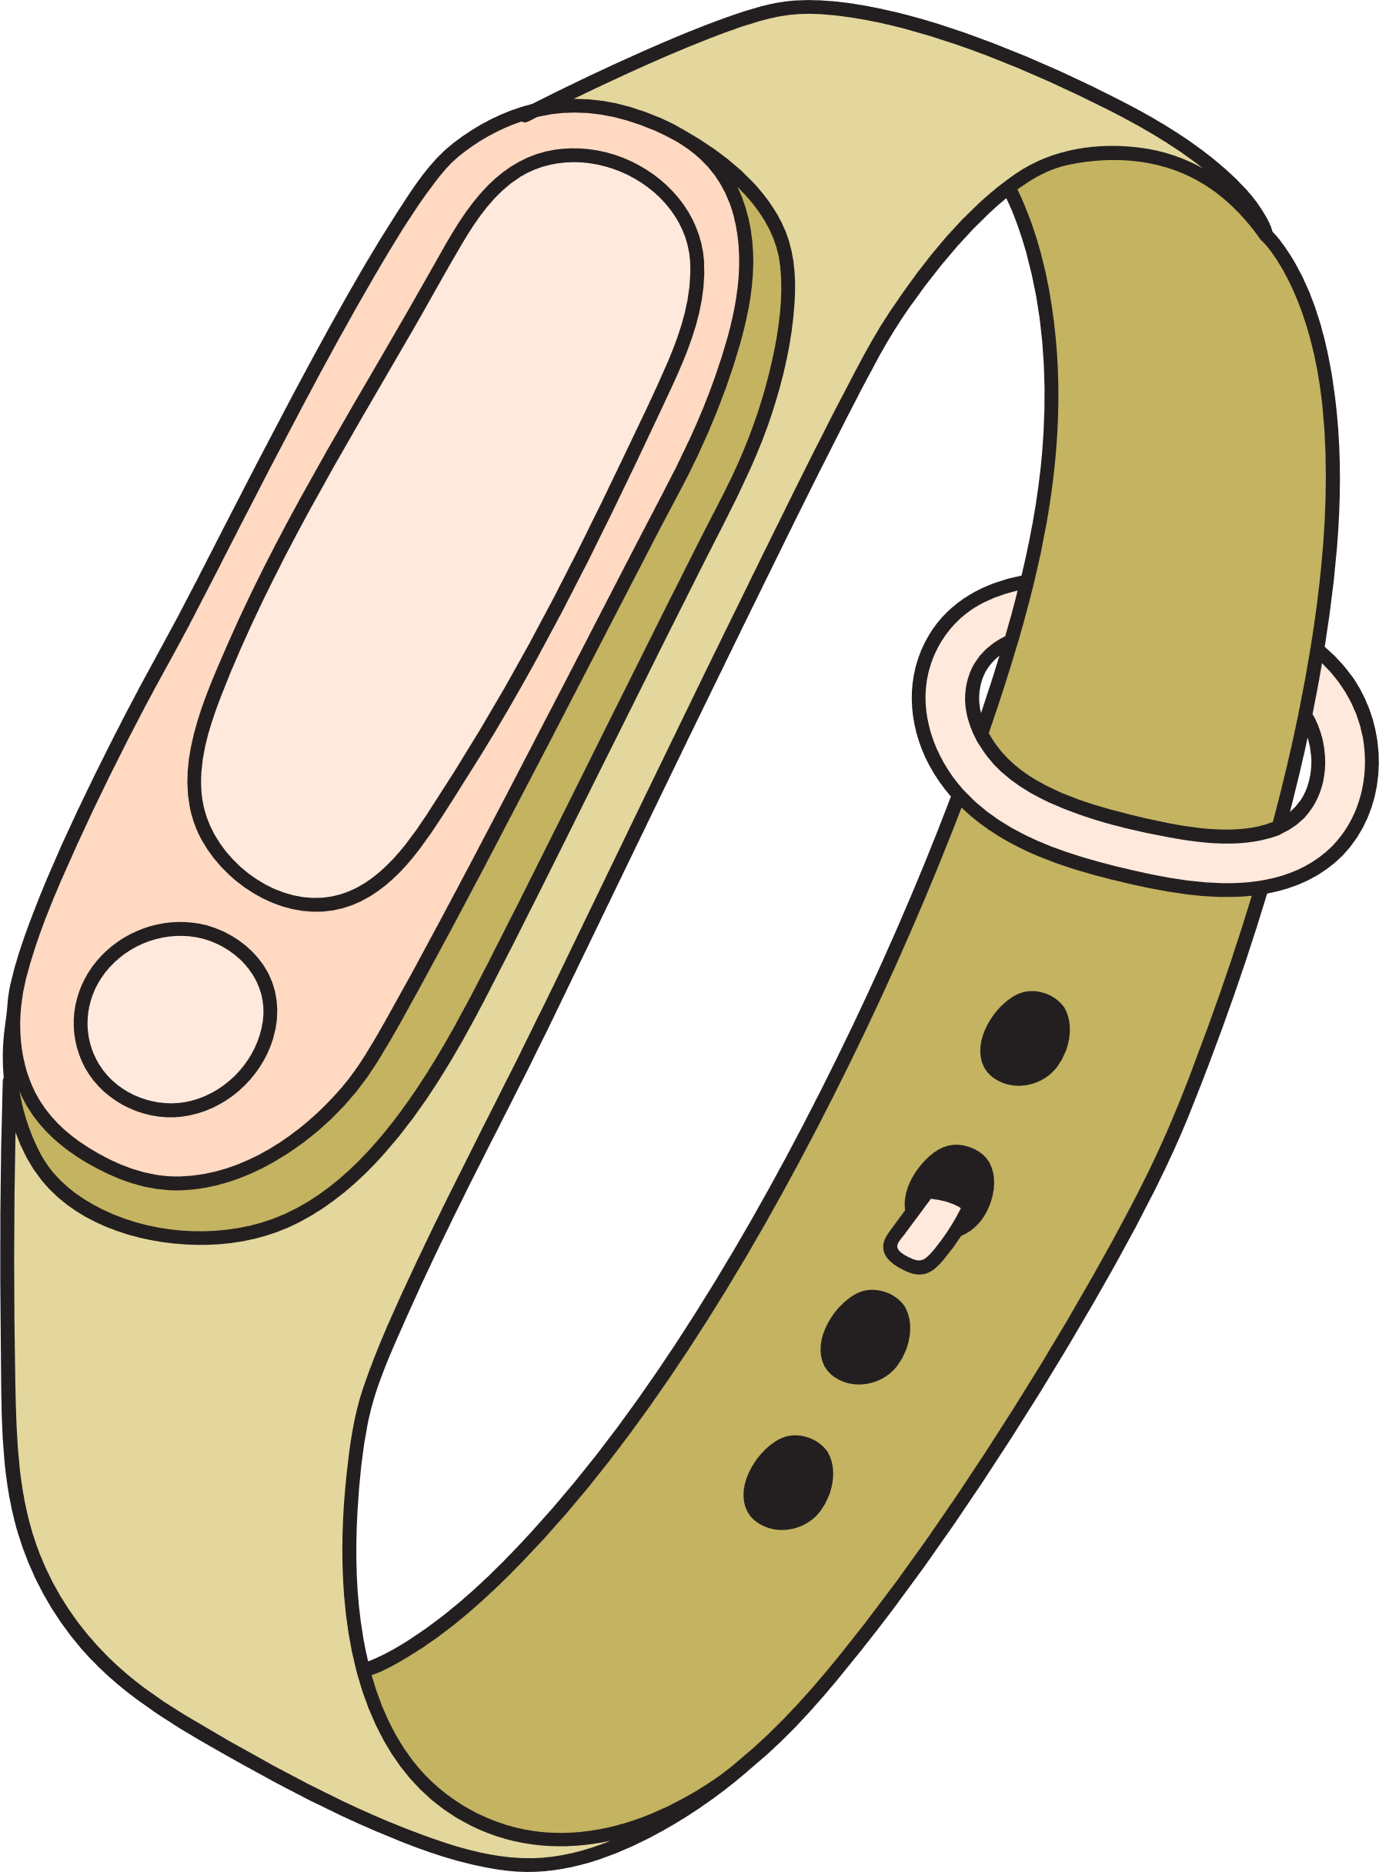


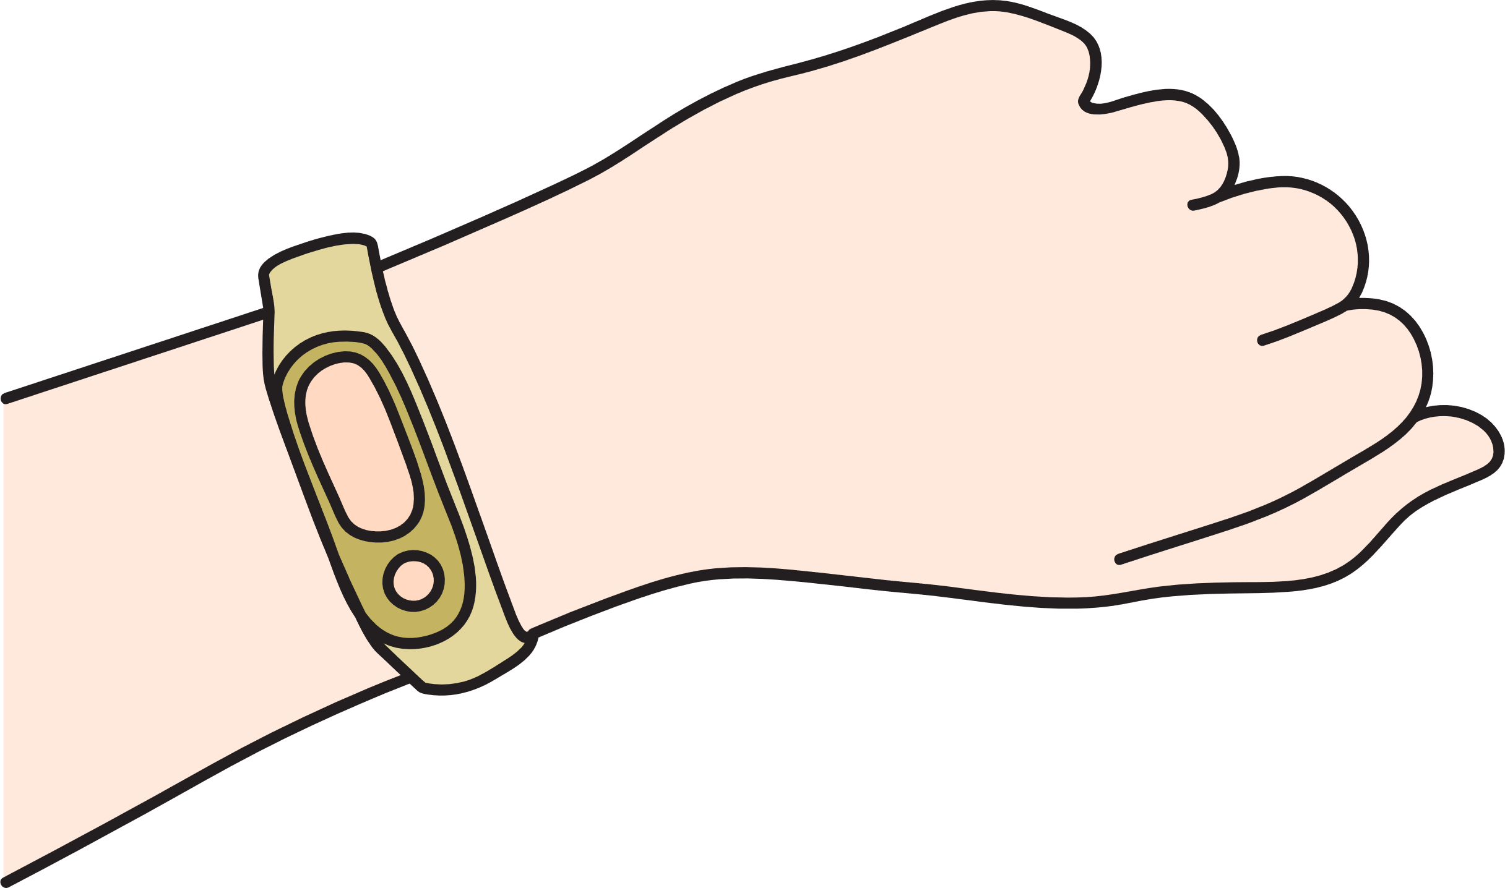


Smart Multi-Sensor Wearable for Real-time Elderly Health Anomaly and Fall Detection

Slide 2
Project ID | R26-IT-108
Research Group | Autonomous Intelligent Machines and Systems (AIMS)
Specialization | Information Technology
Supervisor | Nelum Chathuranga Amarasena

Slide 3



Slide 4

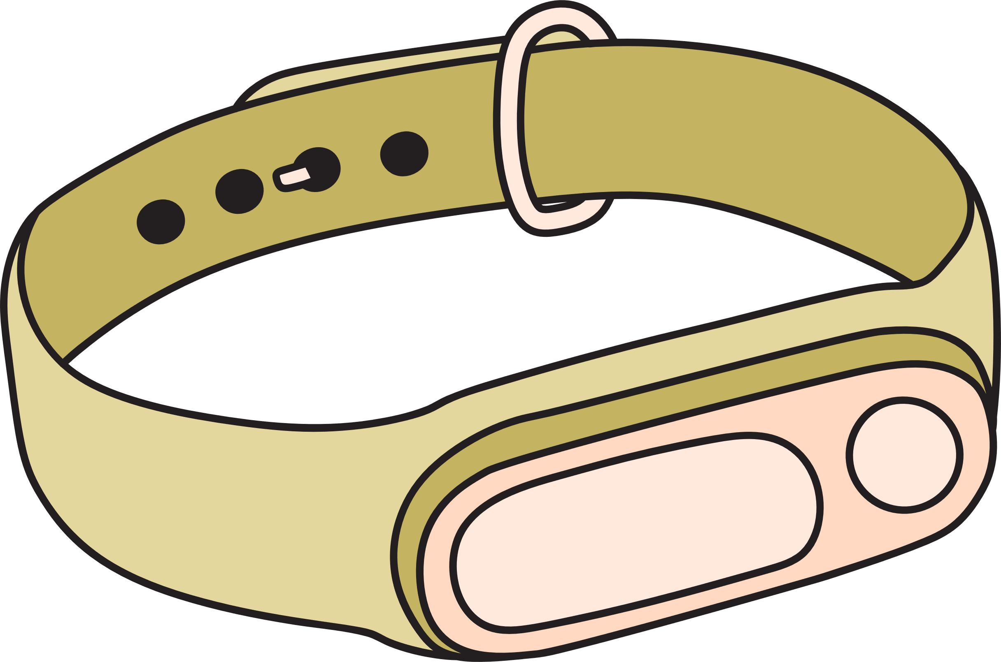







OUR TEAM
Supervisor : Mr. Nelum Chathuranga Amarasena
Cosupervisor : Mr. Samadhi Rathnayake
Name : Abeysinghe S.A.M.M.
IT.No : IT22081148
Name : Lakshan N.K.T.
IT.No : IT22196156
Name : Dissanayaka D.M.S.K.
IT.No : IT22291196
Name : Peshala E.A.P.
IT.No : IT22146410

Slide 5



The Problem: Elderly Health Risks at Home
Elderly individuals living independently often experience undetected health emergencies such as:
These conditions can develop without immediate warning, leading to delayed medical intervention.
Falls
Silent hypoxia (low oxygen levels without symptoms)
Cardiac arrhythmias
Stress or internal pain
Evidence
Falls are the leading cause of injury-related deaths among elderly people.
Silent physiological deterioration can occur hours before symptoms appear.

Slide 6





Users and Stakeholders
Primary Users
Stakeholders
individuals aged 65+ living independently
Family members and caregivers
Seniors with chronic health conditions
Hospitals and emergency services
Assisted living facilities
Healthcare providers

Slide 7

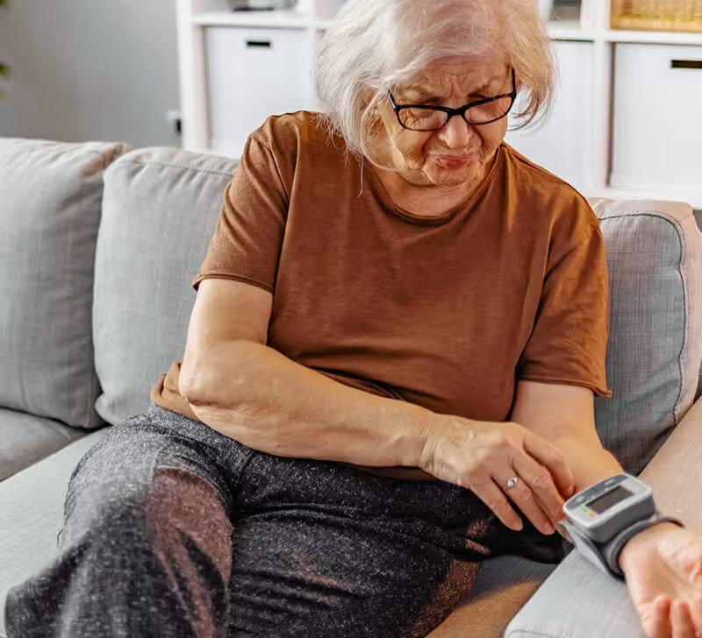
Impact of the Problem
Impact on Individuals
Increased risk of injury and mortality
Loss of independence
Delayed emergency response
Impact on Society
Higher healthcare costs
Increased pressure on emergency services
Emotional stress for families and caregivers

Slide 8
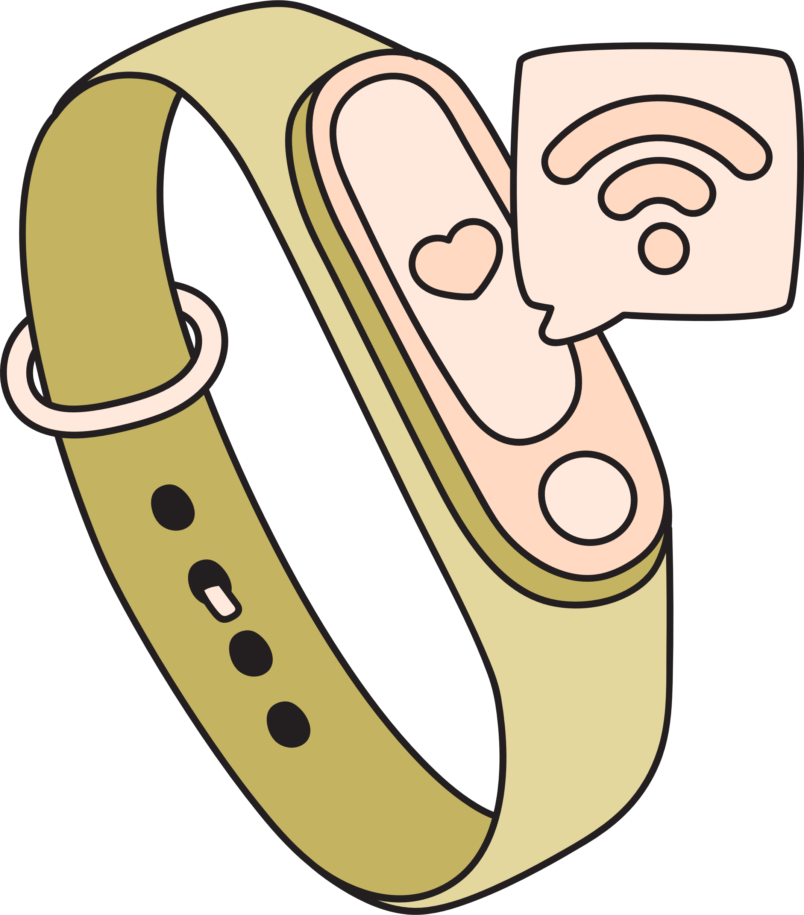
Existing Solutions and Limitations
Existing Systems
Examples:
Apple Watch
Limitations
High false alarm rates
Cloud dependency for analysis
Limited health parameter monitoring
Lack of emotional or neurological monitoring
High cost for elderly users
Fitbit
Basic fall detectors

Slide 9


Proposed Solution
Smart Multi-Sensor Health Monitoring Wearable
A wearable system that monitors multiple physiological signals and detects health anomalies in real time.
Key Features
Sensors Used
Multi-sensor data collection
Edge-based AI processing
Real-time anomaly detection
Immediate alert generation
Heart Rate / SpO₂ Sensor (MAX30102)
Temperature Sensor (MLX90614)
Motion Sensor (MPU6050)
GSR Sensor (Stress Detection)

Slide 10
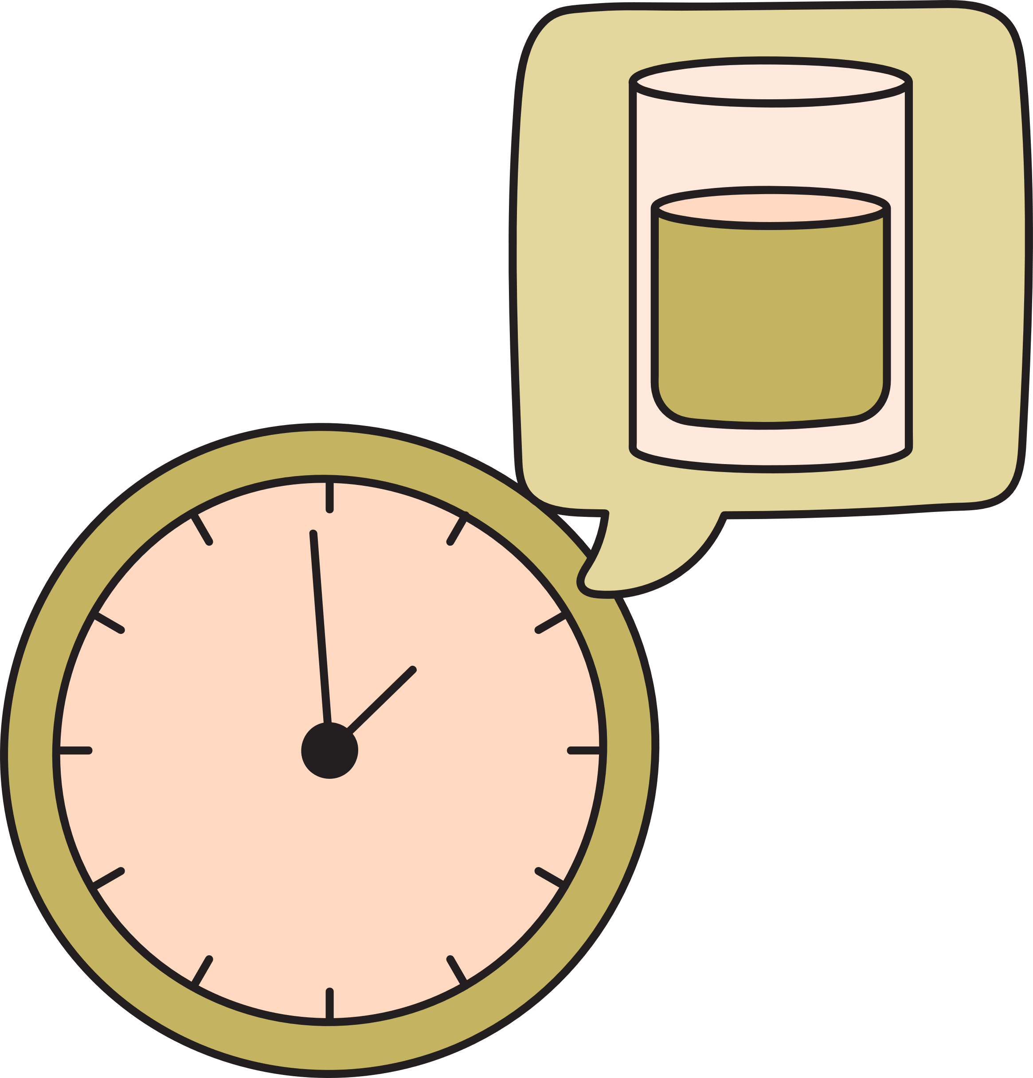
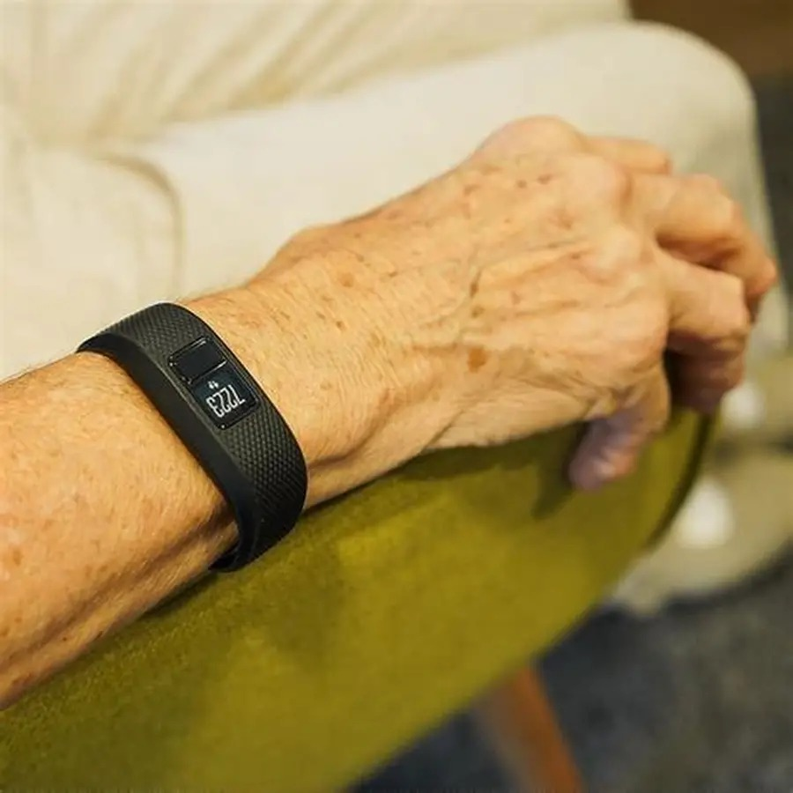
System Overview
Input Layer (Sensors)
Processing Layer
Output Layer
Collect physiological and motion data:
    Heart rate
    Oxygen levels
    Skin temperature
    Motion patterns
    Skin conductance
  ESP32 Microcontroller
  TinyML algorithms
  Sensor fusion analysis
  Local vibration alerts
  Mobile application notifications
  Emergency alert system

Slide 11
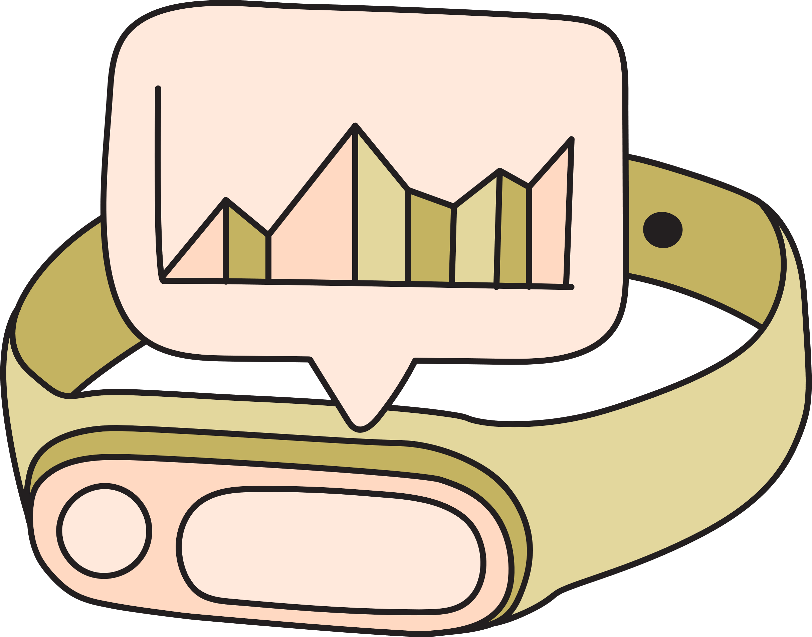
Individual Components (Team Contribution)
Module | Researcher | Function
Cardiovascular Anomaly Detection | Abeysinghe | Detect abnormal heart rhythms
Kinematic Fall Detection | Lakshan | Identify falls and immobility
Respiratory & Thermal Warning | Dissanayaka | Detect hypoxia and sepsis
Neurological Stress Monitoring | Peshala | Detect emotional stress and pain

Slide 12
Cardiovascular Anomaly Detection System
IT22081148 | Abeysinghe S.A.M.M.
Problem Definition
Cardiovascular diseases are one of the leading causes of death among elderly individuals. Many wearable devices measure heart rate but cannot detect irregular heart rhythms (arrhythmia) in real time.
In many existing systems, data is sent to cloud servers for analysis, which introduces latency, privacy risks, and dependency on internet connectivity.
Research Objective
To design and develop a privacy-centric cardiovascular anomaly detection system that uses Edge AI to detect abnormal heart rhythms directly on a wearable device.
Specific Objectives
Acquire real-time PPG signals using the MAX30102 sensor
Develop a signal preprocessing pipeline to remove noise
Train a 1D Convolutional Neural Network (1D-CNN) using the MIT-BIH Arrhythmia dataset
Deploy the optimized model on the ESP32 microcontroller using TinyML

Slide 13
Novelty
Real-time arrhythmia detection on a low-power wearable device
Edge AI processing without cloud dependency
Improved data privacy and faster emergency response
Research Methodology & Domain Knowledge
Technologies and Tools
Hardware
ESP32 microcontroller
MAX30102 PPG sensor
Software
    Python with TensorFlow for model training
    TensorFlow Lite Micro for embedded inference
    PlatformIO for firmware development

Slide 14
Methodology
Validation
Signal Acquisition
  PPG signals collected from MAX30102 sensor
2. Signal Processing
  Noise filtering
  Motion artifact removal
  Feature extraction
Machine Learning Model
  1D-CNN trained using MIT-BIH Arrhythmia dataset
Edge Deployment
  Model quantization for ESP32
  Real-time arrhythmia classification
Dataset: MIT-BIH Arrhythmia Database
Performance metrics: Accuracy, Precision, Recall, and F1-score
Real-time testing with wearable sensor signals

Slide 15
System Overview
The cardiovascular monitoring module follows the pipeline:
PPG Sensor → Signal Processing → 1D-CNN Model → Heart Rhythm Classification
Output
The system classifies heart rhythm into:
Normal heartbeat
Abnormal cardiac anomaly
If an anomaly is detected:
The wearable device generates a vibration alert
A warning notification is sent to the mobile application
Dependencies & Integration
This module works with other system components:
Fall Detection Module – correlates heart rate with movement
Respiratory Monitoring Module – combines HR with oxygen levels
Stress Monitoring Module – analyzes HR with stress signals
Through sensor fusion, this module contributes to the overall multi-sensor intelligent health monitoring system.

Slide 16
Kinematic Fall & Immobility Detection System
IT22196156 | Lakshan N.K.T.
Problem Definition
Falls are one of the leading causes of injury and hospitalization among elderly individuals. Many wearable fall detection systems generate false alarms during daily activities such as sitting quickly, clapping, or dropping objects.
Frequent false alarms cause alarm fatigue, leading users to disable the device and reducing its effectiveness.
Research Objective
To design and implement an accurate fall detection system using motion sensors and edge-based algorithms that can distinguish real falls from normal daily activities.
Specific Objectives
Integrate MPU6050 6-axis IMU sensor with ESP32
Capture real-time motion data at high frequency
Develop a two-stage fall detection algorithm
Implement a lightweight decision-tree model for on-device detection
Reduce false positives compared to traditional threshold systems

Slide 17
Novelty
Two-stage verification fall detection system
Edge-based decision logic running on ESP32
Improved accuracy and reduced false alarms
Real-time detection without cloud processing
Research Methodology & Domain Knowledge
Technologies and Tools
Hardware
  ESP32 microcontroller
  MPU6050 Inertial Measurement Unit (IMU)
Software
    Arduino Framework / PlatformIO
    Python for dataset processing
    C++ for embedded algorithm implementation

Slide 18
Methodology
Validation
1. Motion Data Acquisition
  6-axis motion data collected from accelerometer and gyroscope
2. Feature Extraction
  Resultant Vector Magnitude (RVM)
  Signal Magnitude Area (SMA)
  Orientation angles (pitch and roll)
3. Two-Stage Fall Detection Algorithm
Stage 1 – Impact Detection
    Identify sudden acceleration spikes
Stage 2 – Orientation Verification
    Check if user remains in horizontal position after impact
Benchmark datasets: SisFall and Kfall
Performance evaluation using sensitivity and false alarm rate

Slide 19
System Workflow
IMU Motion Sensor → Motion Feature Extraction → Decision Tree Algorithm → Fall Detection
Detection Process
Detect high-impact acceleration spike
Monitor body orientation and immobility
Confirm fall event before triggering alert
Output
If a fall is detected:
Wearable device triggers vibration alert
Emergency notification sent to mobile application
Caregivers receive real-time alert
Through sensor fusion, this module contributes to the overall multi-sensor intelligent health monitoring system.

Slide 20
Integration with Full System
This module provides motion context for the entire wearable system.
Examples of integration:
Fall detected + abnormal heart rate → emergency situation
High motion + high heart rate → normal physical activity
Fall + immobility → critical alert
This module improves the reliability of the multi-sensor intelligent health monitoring system.

Slide 21
Respiratory & Thermal Warning System
IT22291196 | Dissanayaka D.M.S.K.
Problem Definition
Elderly individuals often experience serious health conditions such as silent hypoxia and sepsis, where vital signs deteriorate before symptoms become noticeable.
Traditional monitoring systems rely on static threshold values (for example SpO₂ below 90%), which can cause frequent false alarms or miss early warning signs.
This delay between physiological deterioration and symptom awareness creates a diagnostic gap in home healthcare monitoring.
Research Objective
To develop a smart respiratory and thermal monitoring system capable of detecting early signs of physiological deterioration using multi-sensor data analysis.

Slide 22
Specific Objectives
Integrate MAX30102 pulse oximeter to monitor SpO₂ and heart rate
Integrate MLX90614 infrared sensor to measure body temperature
Develop a multi-parameter anomaly detection algorithm
Implement K-Means clustering for personalized health baseline detection
Deploy the algorithm on the ESP32 microcontroller for real-time monitoring
Novelty
Multi-parameter vital sign correlation instead of single-threshold detection
Personalized physiological baseline (Homeostasis Zone)
Edge-based anomaly detection using unsupervised machine learning

Slide 23
Research Methodology & Domain Knowledge
Technologies Used
Hardware
    ESP32 microcontroller
    MAX30102 pulse oximeter sensor
    MLX90614 infrared temperature sensor
Software
    Python (Scikit-learn) for model development
    Arduino / C++ for embedded system implementation
Methodology
Data Acquisition
  Collect physiological signals including SpO₂, heart rate, and skin temperature
Signal Preprocessing
  Noise filtering
  Sensor calibration

Slide 24
3. Unsupervised Machine Learning
  Use K-Means clustering to establish a personalized vital sign baseline
4. Anomaly Detection
  Measure deviation from baseline using Euclidean distance
Validation
Clinical dataset reference: MIMIC-III dataset
Performance evaluated using accuracy and anomaly detection rate
System Workflow
Temperature Sensor + SpO₂ Sensor → Data Processing → K-Means Algorithm → Health Status Classification
Detection Capabilities
The systemcan detect early warning signs of :
Silent hypoxia (low oxygen levels)
Early-stage infection or sepsis
Respiratory deterioration

Slide 25
Alert Mechanism
When abnormal patterns are detected:
  Wearable device triggers vibration alert
  Notification sent to mobile caregiver application
Integration with Full System
This module contributes vital sign monitoring to the overall wearable system.
Examples of integration:
  Temperature increase + elevated heart rate → infection risk
  Low SpO₂ + immobility → respiratory emergency
  Stress signals + abnormal vitals → potential health deterioration
This module enhances the system’s ability to perform predictive health monitoring for elderly individuals.

Slide 26
Neurological Stress & Pain Monitoring System
IT22146410 | Peshala E.A.P.
Problem Definition
Many elderly patients, especially those with dementia, Alzheimer’s disease, or stroke, may lose the ability to verbally communicate their pain or emotional distress. As a result, caregivers often rely on subjective observation, which can lead to delayed treatment and reduced quality of care.
Existing wearable devices mainly monitor physical parameters such as heart rate and step count but do not detect emotional stress or internal pain conditions.
Research Objective
To design and implement a Neurological Stress and Pain Monitoring system that can detect emotional distress in elderly individuals using physiological signals.
Specific Objectives
Measure Galvanic Skin Response (GSR) to detect emotional arousal
Analyze Electrodermal Activity (EDA) signals
Train a Random Forest machine learning model using the WESAD dataset
Deploy the optimized model on the ESP32 microcontroller
Detect stress and pain events in real time

Slide 27
Novelty
Introduction of Affective Computing in elderly healthcare wearables
Objective detection of stress and pain using physiological signals
Edge-based machine learning processing for real-time emotional state detection
Technologies Used
Hardware
    ESP32 microcontroller
    Galvanic Skin Response (GSR) sensor
    Skin conductance electrodes
Software
  Python (Scikit-Learn) for machine learning model training
  PlatformIO / Arduino framework for embedded implementation
Methodology
Physiological Signal Acquisition
  Continuous monitoring of skin conductance using GSR sensor

Slide 28
2. Signal Processing
  Separation of tonic and phasic Electrodermal Activity (EDA) components
  Detection of Skin Conductance Response (SCR) peaks
3. Machine Learning Classification
  Random Forest model trained using WESAD dataset
4. Edge Deployment
  Model optimized and deployed on ESP32 for real-time detection
Validation
Dataset used: WESAD – Wearable Stress and Affect Detection Dataset
Evaluation metrics: Accuracy, Precision, and F1-score
System Workflow
GSR Sensor → Signal Processing → Feature Extraction → Random Forest Model → Stress Classification

Slide 29
Detection Capabilities
The system identifies physiological indicators of:
Silent hypoxia (low oxygen levels)
Early-stage infection or sepsis
Respiratory deterioration
This module enhances the wearable system by providing psychological and neurological monitoring, enabling a more holistic approach to elderly healthcare monitoring.
Alert Mechanism
If a distress state is detected:
  Wearable device triggers vibration alert
  Notification sent to mobile caregiver application
Integration with Full System
This module provides emotional state monitoring within the multi-sensor wearable system.
Examples of integration:
Stress signal + high heart rate → emotional distress
Stress signal + low motion → pain condition
Stress signal + abnormal vital signs → medical alert

Slide 30
Commercialization
Market Opportunity
Growing demand for elderly healthcare monitoring devices.
Target Market
Value Proposition
Elderly individuals living alone
Assisted living facilities
Home healthcare services
Real-time health monitoring
Privacy-preserving edge AI
Multi-sensor health detection

Slide 31
Project Planning
Work Breakdown Structure
Task | Subtasks
Project Management and Planning | Define scope, Risk assessment, Timeline setup
System Design | Design architecture, Define specifications, Data flow
Hardware Integration | Select sensors, Interface hardware, Develop prototype
Data Processing and Algorithms | Preprocess data, Implement ML models, Anomaly detection
Software Development | Develop embedded software, Mobile app, Alert system
Testing and Validation | Prototype testing, Usability testing, System integration
Deployment and Final Integration | Finalize design, Deploy to users, Collect feedback
Documentation and Reporting | Write reports, User manuals, Submit publications

Slide 32
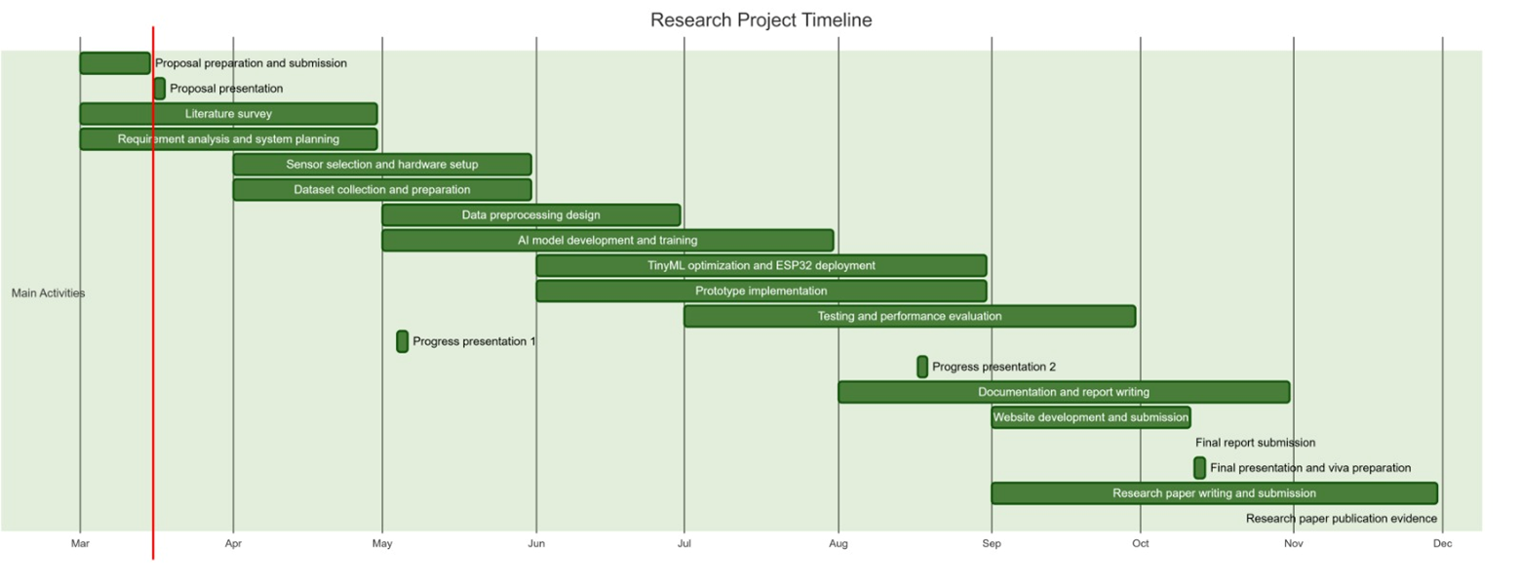
Gantt Chart

Slide 33
References
Chen, M., Zhang, Y., Li, Y. and Yang, X., 2022. A Systematic Review of Wearable Sensor‑Based Technologies for Fall Risk Assessment in Older Adults. Sensors, 22(18), p.6752. Available at: https://doi.org/10.3390/s22186752
Kristoffersson, A. and Lindén, M., 2022. A Systematic Review of Wearable Sensors for Monitoring Physical Activity. Sensors (Basel), 22(2), p.573. Available at: https://doi.org/10.3390/s22020573
Hizem, M., Bouaziz, I., Mili, L. and Guesmi, S., 2025. Reliable ECG Anomaly Detection on Edge Devices for Internet of Medical Things Applications. Sensors, 25(8), p.2496. Available at: https://doi.org/10.3390/s25082496
Gu, B., Lee, S., Yoon, Y., Choi, H., and Kim, S., 2025. Advancements in Wearable Sensor Technologies for Health Monitoring in Terms of Clinical Applications, Rehabilitation, and Disease Risk Assessment: Systematic Review. JMIR mHealth and uHealth, 14, p.e76084. Available at: https://doi.org/10.2196/76084
Bet, P., Castro, P.C. and Ponti, M.A., 2019. Fall Detection and Fall Risk Assessment in Older Persons Using Wearable Sensors: A Systematic Review. International Journal of Medical Informatics, 130, p.103946. Available at: https://doi.org/10.1016/j.ijmedinf.2019.08.006
Kristoffersson, A. and Lindén, M., 2020. A Systematic Review on the Use of Wearable Body Sensors for Health Monitoring: A Qualitative Synthesis. Sensors (Basel), 20(5), p.1502. Available at: https://doi.org/10.3390/s20051502

